Slide 1
Generating cash for fintechs
Est. 2011
This pitch deck is highly confidential. Do not share with external sources.

Slide 2
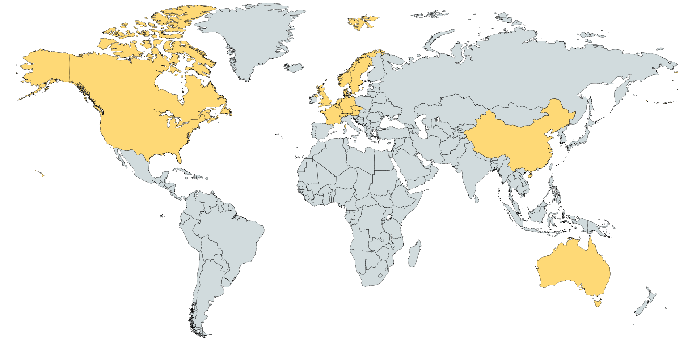
facts and figures
Established Aug 2011
Clients in 4 continents
6 people and growing
Multi-million € total deal value every year
This pitch deck is highly confidential. Do not share with external sources.

Slide 3
What do we do?
NOW :
Technology broker: Sales revenue generation and growth
Market research
Lead generation and prospection
Sales and account management
Sales consulting
COMING SOON :
This pitch deck is highly confidential. Do not share with external sources.

Slide 4
“Forum Digitalum Romanum” for the European Fintech eco-system
This pitch deck is highly confidential. Do not share with external sources.

Slide 5
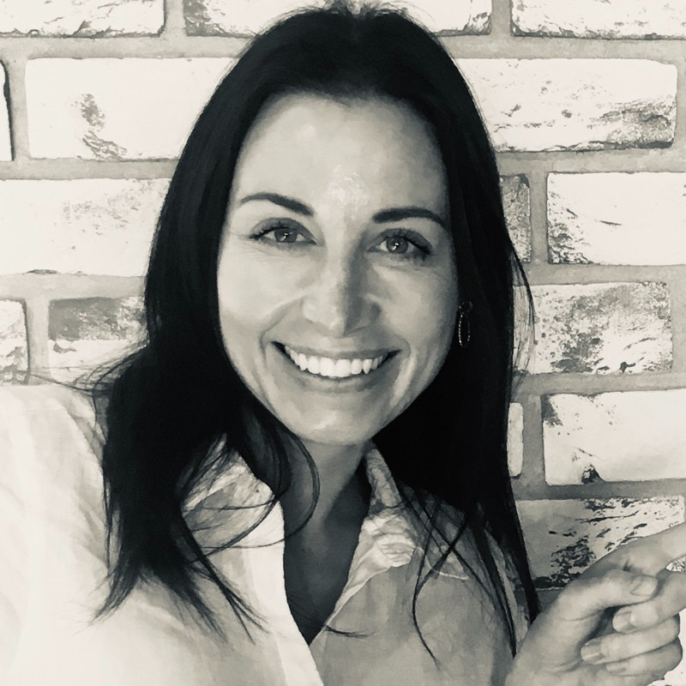
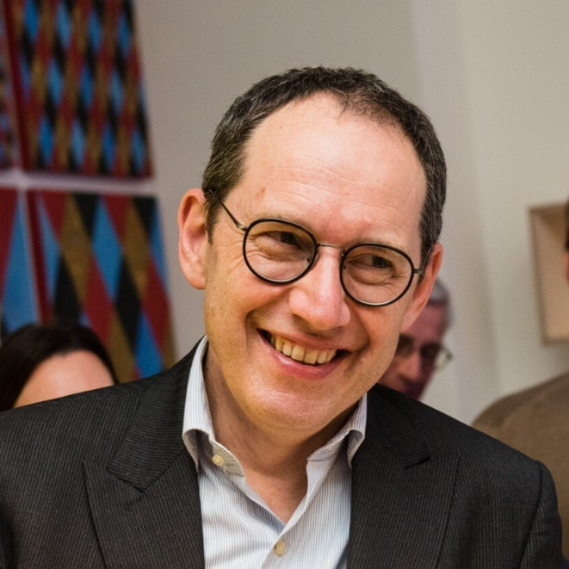
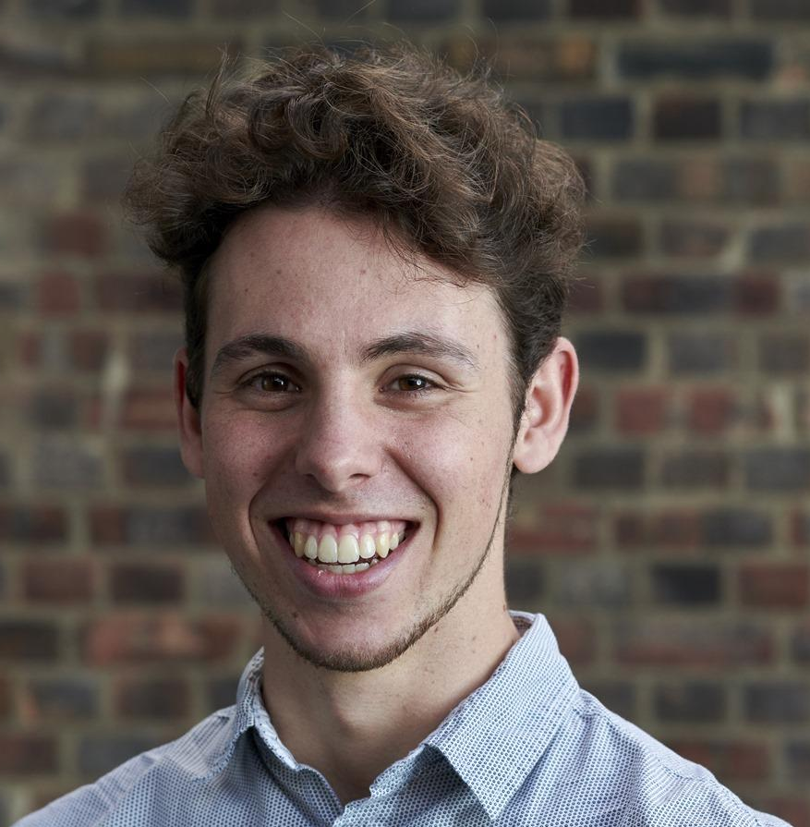
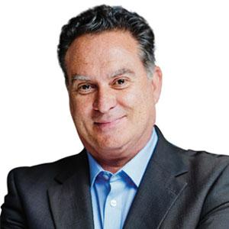
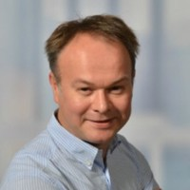
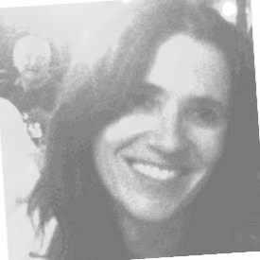
Byrssa Founding Team
Byrssa Advisory Board
Gabriela Homolova
Business and financial
Willem Lambrechts
Sales and industry
Matthias De Deyn
Program management
Fabian Vandenreydt
Eco-system expert
Joeri Van der Stappen
Technical expert
Sophie Fleur Dewaele
Legal expert
This pitch deck is highly confidential. Do not share with external sources.

Slide 6
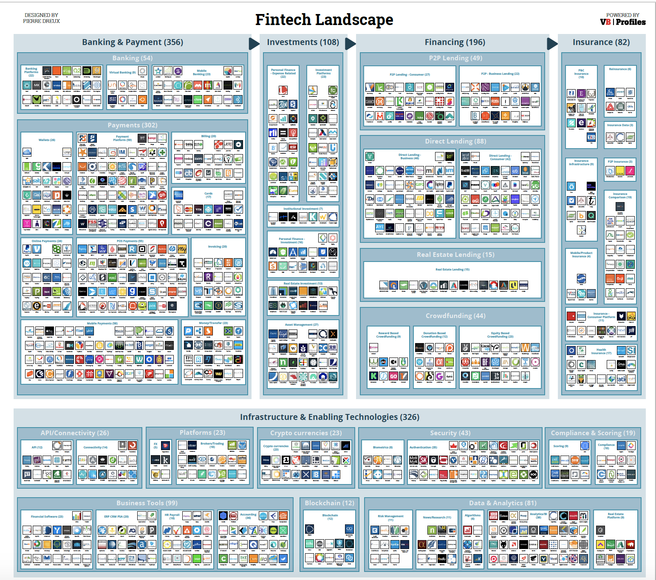
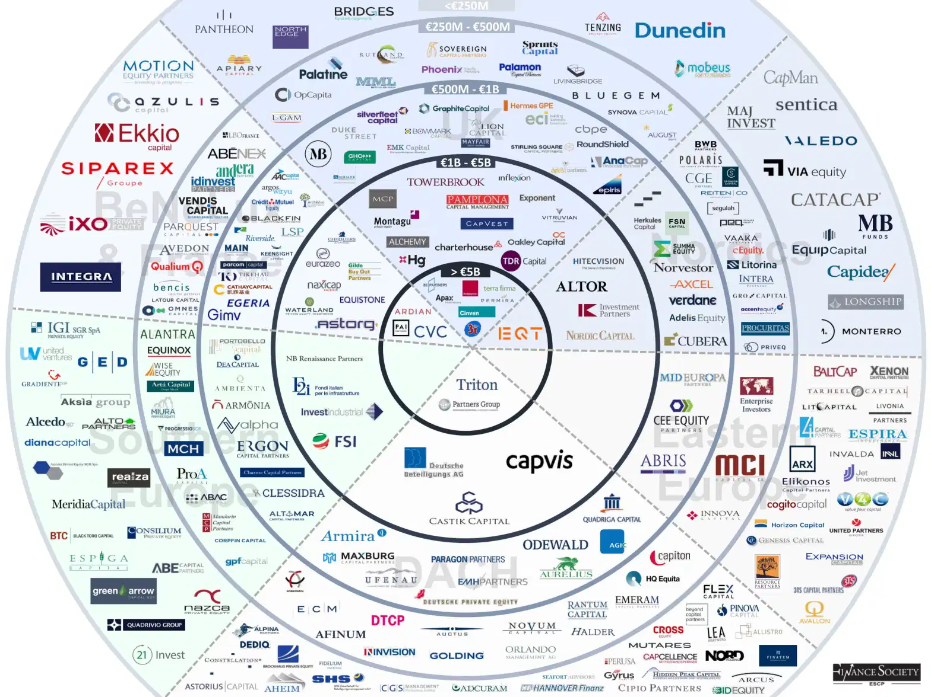
What’s the problem?
European VC Landscape
This pitch deck is highly confidential. Do not share with external sources.

Slide 7
What’s going on in finance sector?
This pitch deck is highly confidential. Do not share with external sources.

Slide 8
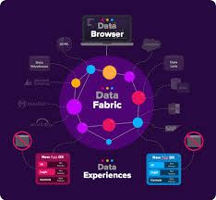
Industry bodies
(non-profit)
Vendors and Service providers
(incl. banks)
referrals
clients
memberships
advertising
networking
networking
Data
&
Analytics
Match-making
analytics
analytics
Market
offerings
investing
networking
networking
analytics
analytics
Start-up
(pre-seed ➜ series A,...)
Investors
(VC’s, Funds, Family offices, corporate investors, banks)
guidance
This pitch deck is highly confidential. Do not share with external sources.

Slide 9
Byrssa market components
Registration and subscription choice
Payment
Profiling
KYC
Free content
Data upload/data access (public or private)
Communications
Data search and analytics
Issuance
Investment
Reference Data
Bulletin Board
Free
Standard
Premium
This pitch deck is highly confidential. Do not share with external sources.

Slide 10
Byrssa Road Map
2020
2021
IQ
2021
2Q
2021
3Q
2021
4Q
Initial idea
Market consultation
Technology consultation
Advisory board established
Feasibility study completion
BYRSSA Market development
BYRSSA LUX office set up
BYRSSA holding founded
Launch pre-seed fundrasing
MVP development
Key partners and suppliers contracts signed
Completion and launch BYRSSA STO
Year 2022 launch BYRSSA FinTech Market

Slide 11
BYRSSA mission :
Unite the whole European fintech eco-system on one single market infrastructure.
Provide a trusted and transparent digital marketplace for private equity issuance and trading.
Be a leader and frontrunner in applying newest technology developments
Become the “Forum Digitalum Romanum” for European fintech
This pitch deck is highly confidential. Do not share with external sources.

Slide 12
Feasibility study Byrssa STO
Project viability
Market participant research
Legal framework assessment

Slide 13
So what IS new?
European Fintech focus
One market for the whole Fintech eco-system
Vertical all-in-one approach : Discovery, Research, Outreach, Matching, Deal
Assembling best-fit-for-purpose technologies :
Choice for regulated market
No-code Data-fabric
Built-for-purpose blockchain
STO specialized
Private Equity gets digital and liquid
This pitch deck is highly confidential. Do not share with external sources.

Slide 14
Conclusion :
“TECHNOLOGY IS BEST ZHEN IT BRINGS
PEOPLE TOGETHER.”
MATT MULLENWEG
“PEOPLE ARE BEST WHEN THEY BRING TECHNOLOGY TOGETHER.”
WILLEM LAMBRECHTS
This pitch deck is highly confidential. Do not share with external sources.

Slide 15
CONTACT
Curious? Feel free to contact us!
Willem Lambrechts w.lambrechts@drebbel.eu
This pitch deck is highly confidential. Do not share with external sources.

